Slide 1

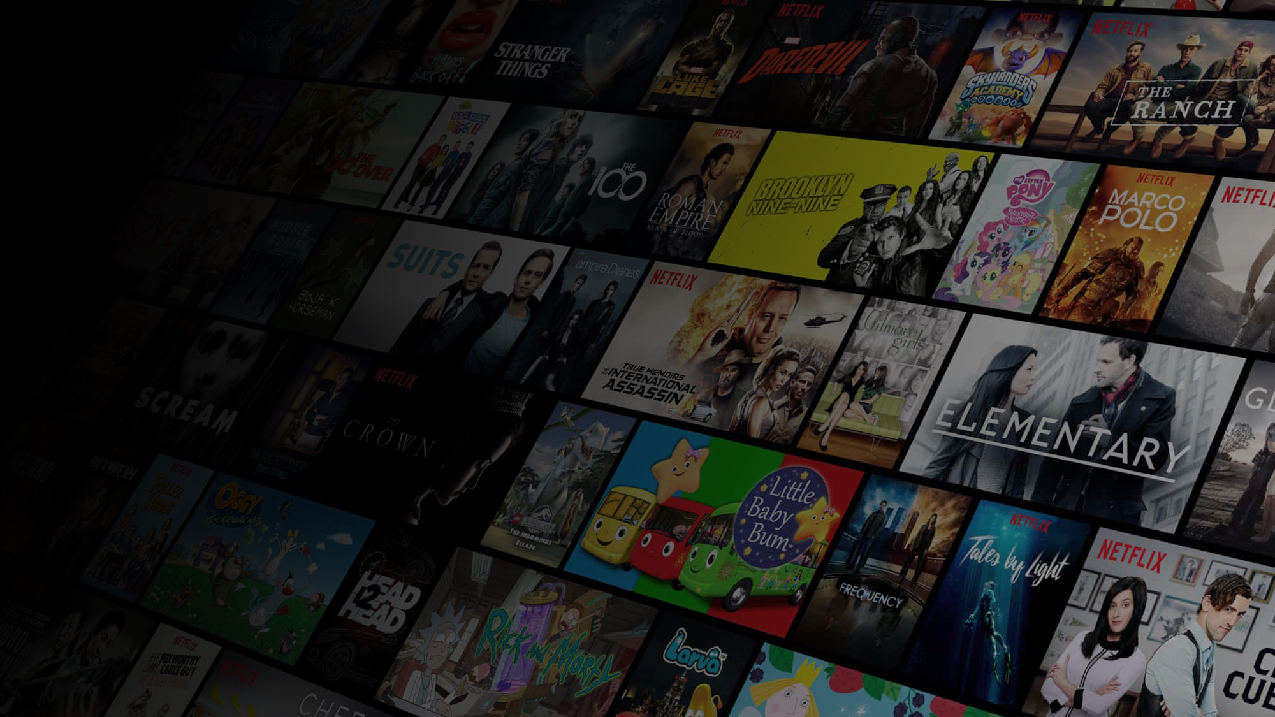
What should you see next?
Exploring network-based recommendation systems using Netflix data
Group 5
Sameen Haroon Abhishek Saha Sharon Xu Zeyu Zhu

Slide 2
Agenda
1
Introduction to recommender systems and our plan
2
Results from data exploration
3
Review of modeling techniques
4
Initial findings

Slide 3







Our project focuses on recommender systems which combine big data with practical business applications
Recommender systems rely on the properties of items that each user likes or/and compute a similarity index between users based on their likes and recommend items to them accordingly.
Viewed by both users
Data foundation
5
5
Explicit user ratings after watching a movie or listening to a song,
Implicit search engine queries and purchase histories
Other knowledge about the users/items themselves.
4
5
Business applications
Similar user 1
Similar user 2
5
Used by major companies such as Netflix, YouTube, Spotify or Amazon
Support a variety of product recommendations, e.g. for entertainment content or item purchases
Enable companies to personalize customer offers and experience
Good systems drive competitive advantage by speeding up searches and providing users with most effective recommendations
Viewed and highly rated by her, Recommend to him!

Slide 4
Recommender systems can be used with both network-based and content-based techniques
Collaboration-based
Content-based
 | Jimmy | Lucy | Windy
Avatar | 5 | 4 | 4
Coco | 4 | ? | 3
Star Wars | 3 | 3 | ?
Se7en | 2 | 3 | 5
Adventure
Action
Fantasy
DC
Romantic
Crime
Wonder
Woman
Suicide
Squad
utilizes user interactions to filter for items of interest
the set of interactions can be represented in a matrix, where each entry represents the interaction between user i and item j.
the prediction of this approach is the value of any missing interaction
is based on the assumption that similarities can be used to predict positive interactions
uses product and user features to produce recommendations
is based on the assumption that similar attributes of items can be used to predict positive interactions
one concern with these is the possibility of excessive specialization, where a user only receives recommendations based on what they already like
**There is also a third approach that seeks to combine both collaboration and content-based techniques, called hybrid recommender systems

Slide 5
Our specific focus is to build a recommender system using social networks from Netflix data
Our motivation
Our plan
Why Netflix
Data Exploration
subscription service model that offers personalized recommendation
data readily available in public domain due to a competition in late 2000s
while lots of systems have been built, there is an opportunity to focus on social network analysis
Conduct initial network explorations of user-movie and movie-movie networks
Model Creation & Comparison
Build models using different recommender algorithms
Evaluate these algorithms using
regression-based metrics on predicted ratings e.g. RMSE
classification-based metrics on top-N recommendations e.g. AUC
Why use collaborative approach
data format supports network-based findings (no user/movie attributes)
opportunity to identify interesting patterns in the ratings network overall
room to further compare and validate existing beliefs on the different collaborative filtering techniques
Step 03
Implications
Step 04
Review how performance compares against traditional expectations
Examine performance of best recommender algorithm on test set

Slide 6
We are working with large scale data that contains 100M+ observations
17,770
unique movies
480,189
unique users
6+
years of data
100M+
ratings

Slide 7
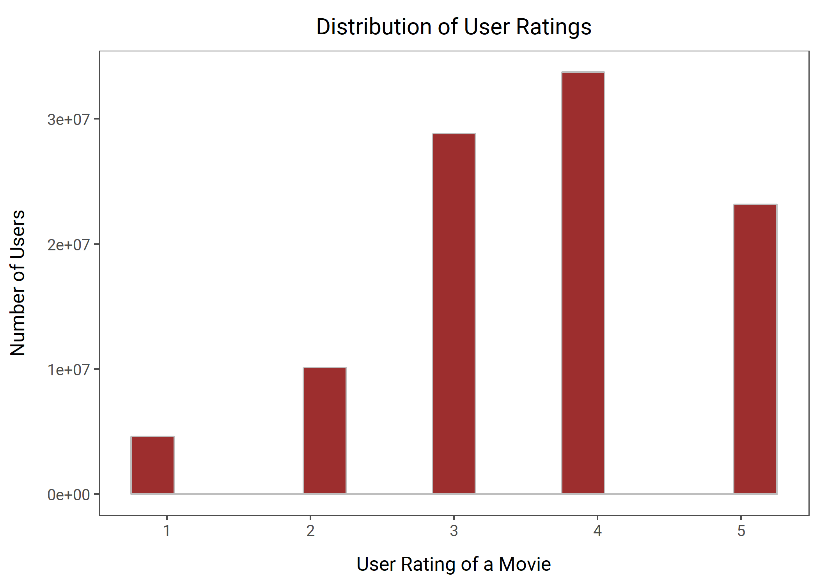
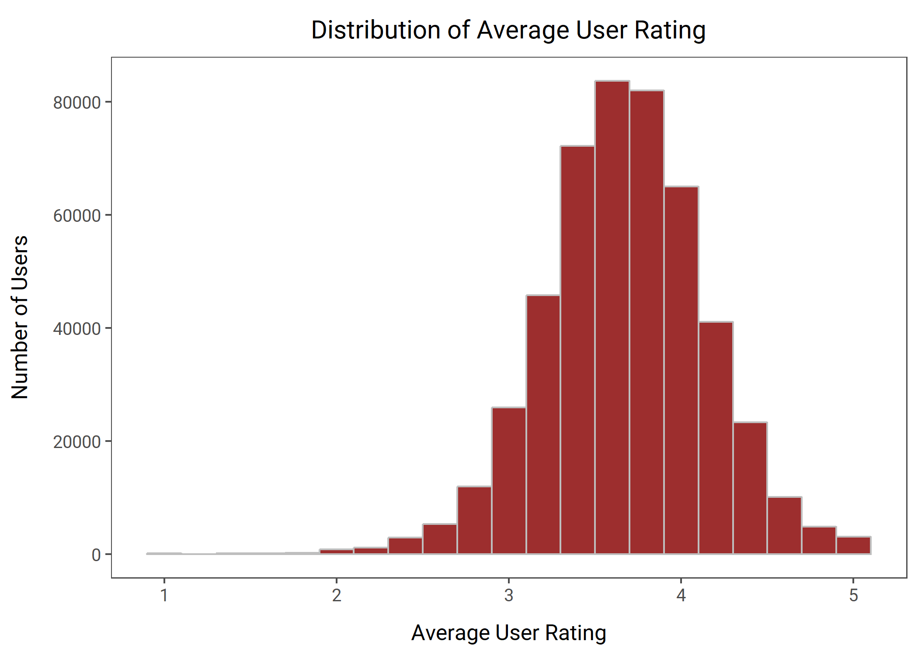
Looking closer at user ratings of movies, we see a tendency to rate high and potential user bias
Individual movie ratings tend to skew high since people choose the movies they watch
The distribution of average user rating suggests some user bias may exist

Slide 8
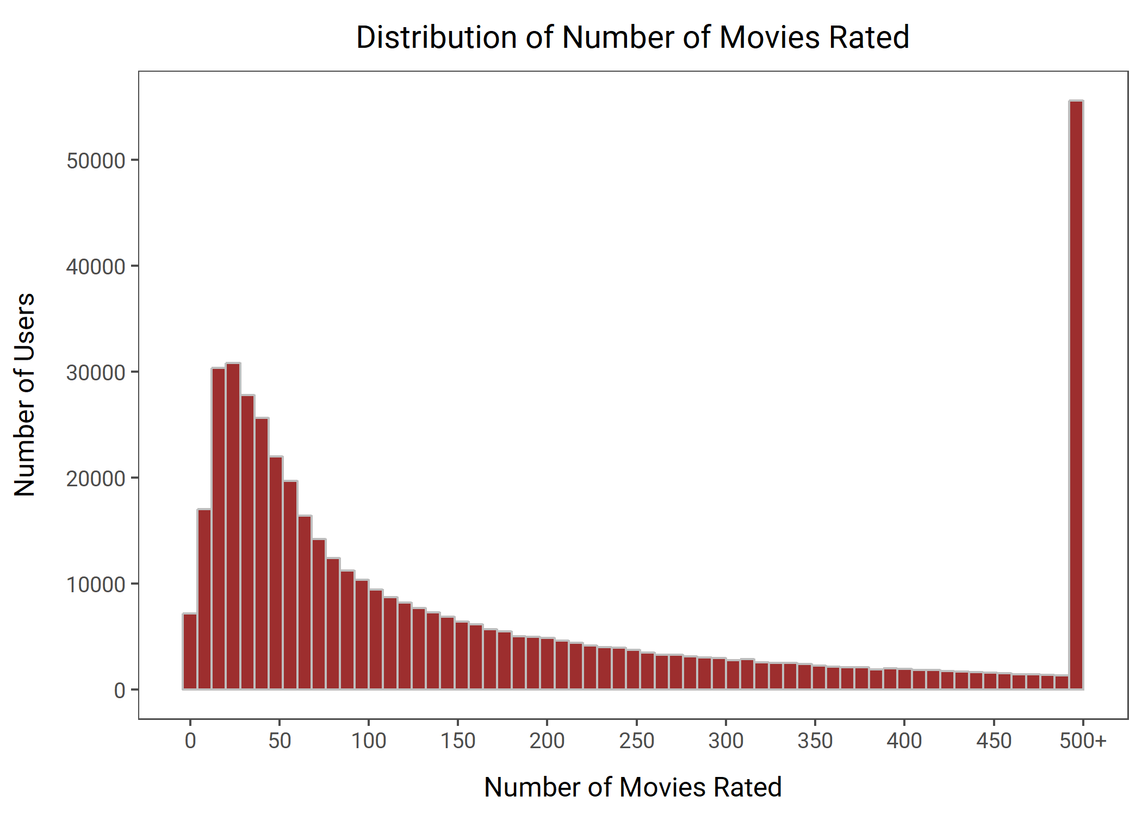
Data includes extensive movie ratings
Distribution of number of movies each user has rated
209
average number of movies rated per user
96
median number of movies rated per user
5600+
average number of ratings per movie
561
median number of ratings per movie
While some customers have rated only 1 movie…
…others have gone as high as 17000+

Slide 9










Examples of notable movies based on the data
Movies with highest number of ratings
Movies with highest average ratings
Miss Congeniality
Independence day
The patriot
The Lord of the Rings:
The Return of the King
The Lord of the Rings:
The Fellowship of the Ring
The Lord of the Rings:
The Two Towers
The day after tomorrow
Pirates of the Caribbean:
The Curse of the Black Pearl
Lost: Season 1
Battlestar Galactica: Season 1

Slide 10
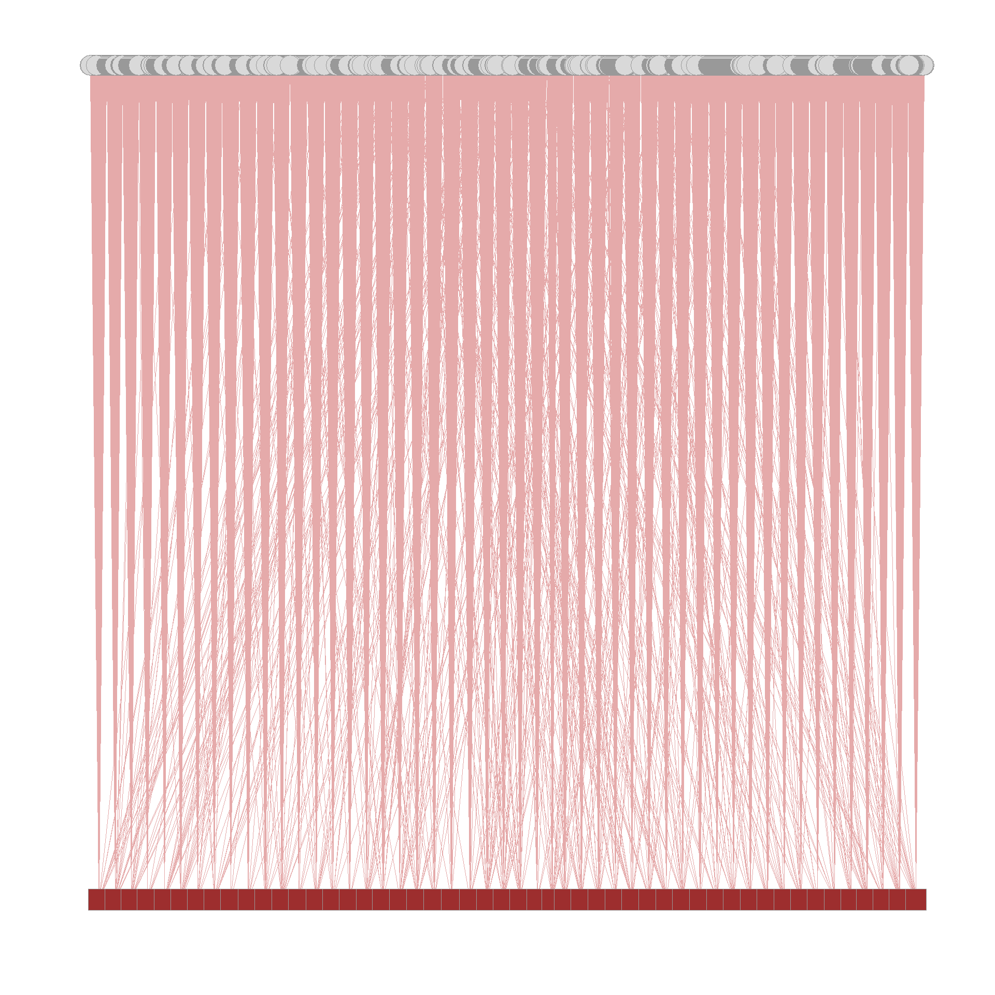
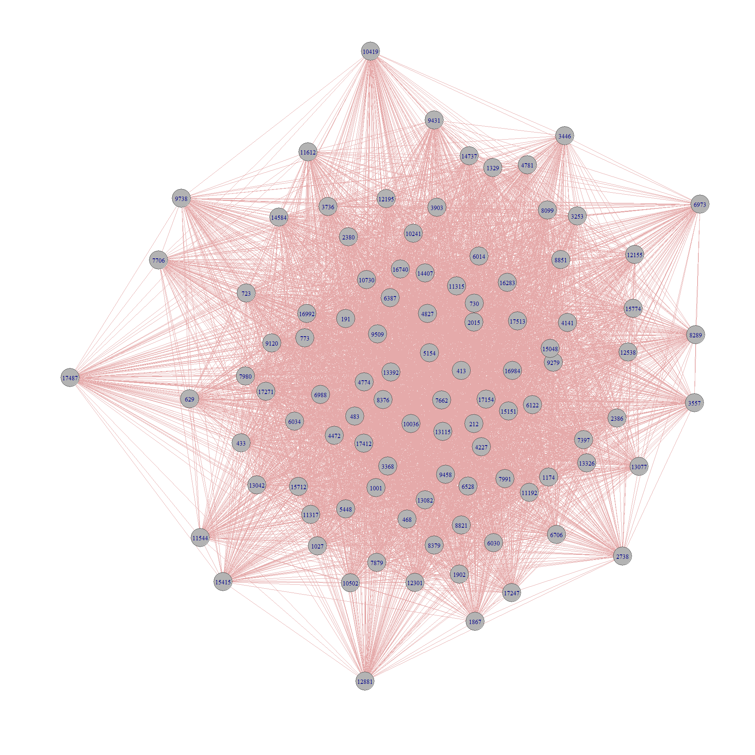
To further explore our data, we examined two specific networks
User-Movie Bipartite Network
Movie-Movie Co-Affiliation Network
Each edge connects a movie to a user who rated it
Each edge connects two movies seen by a user
Users
Movies

Slide 11
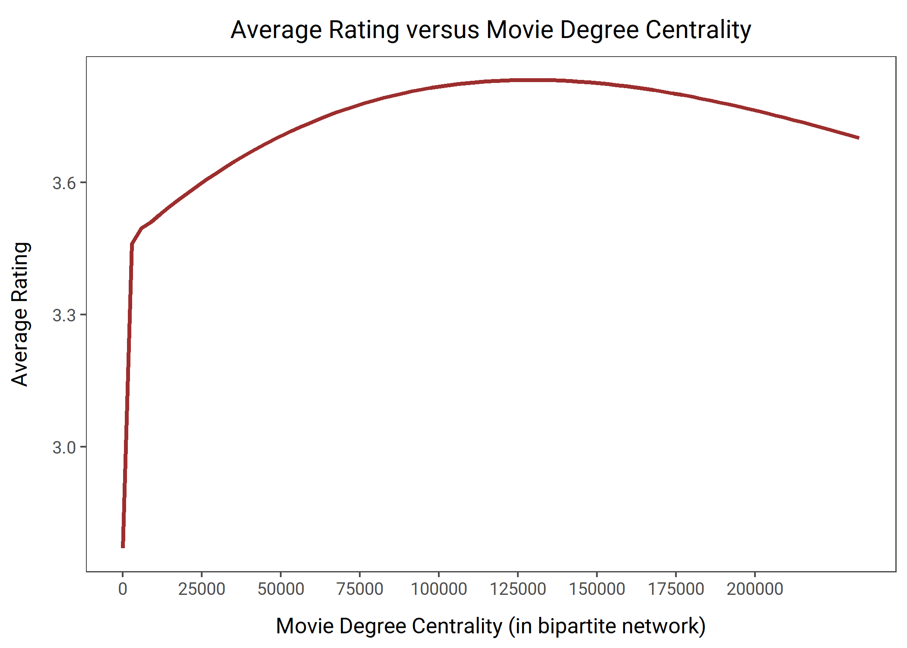
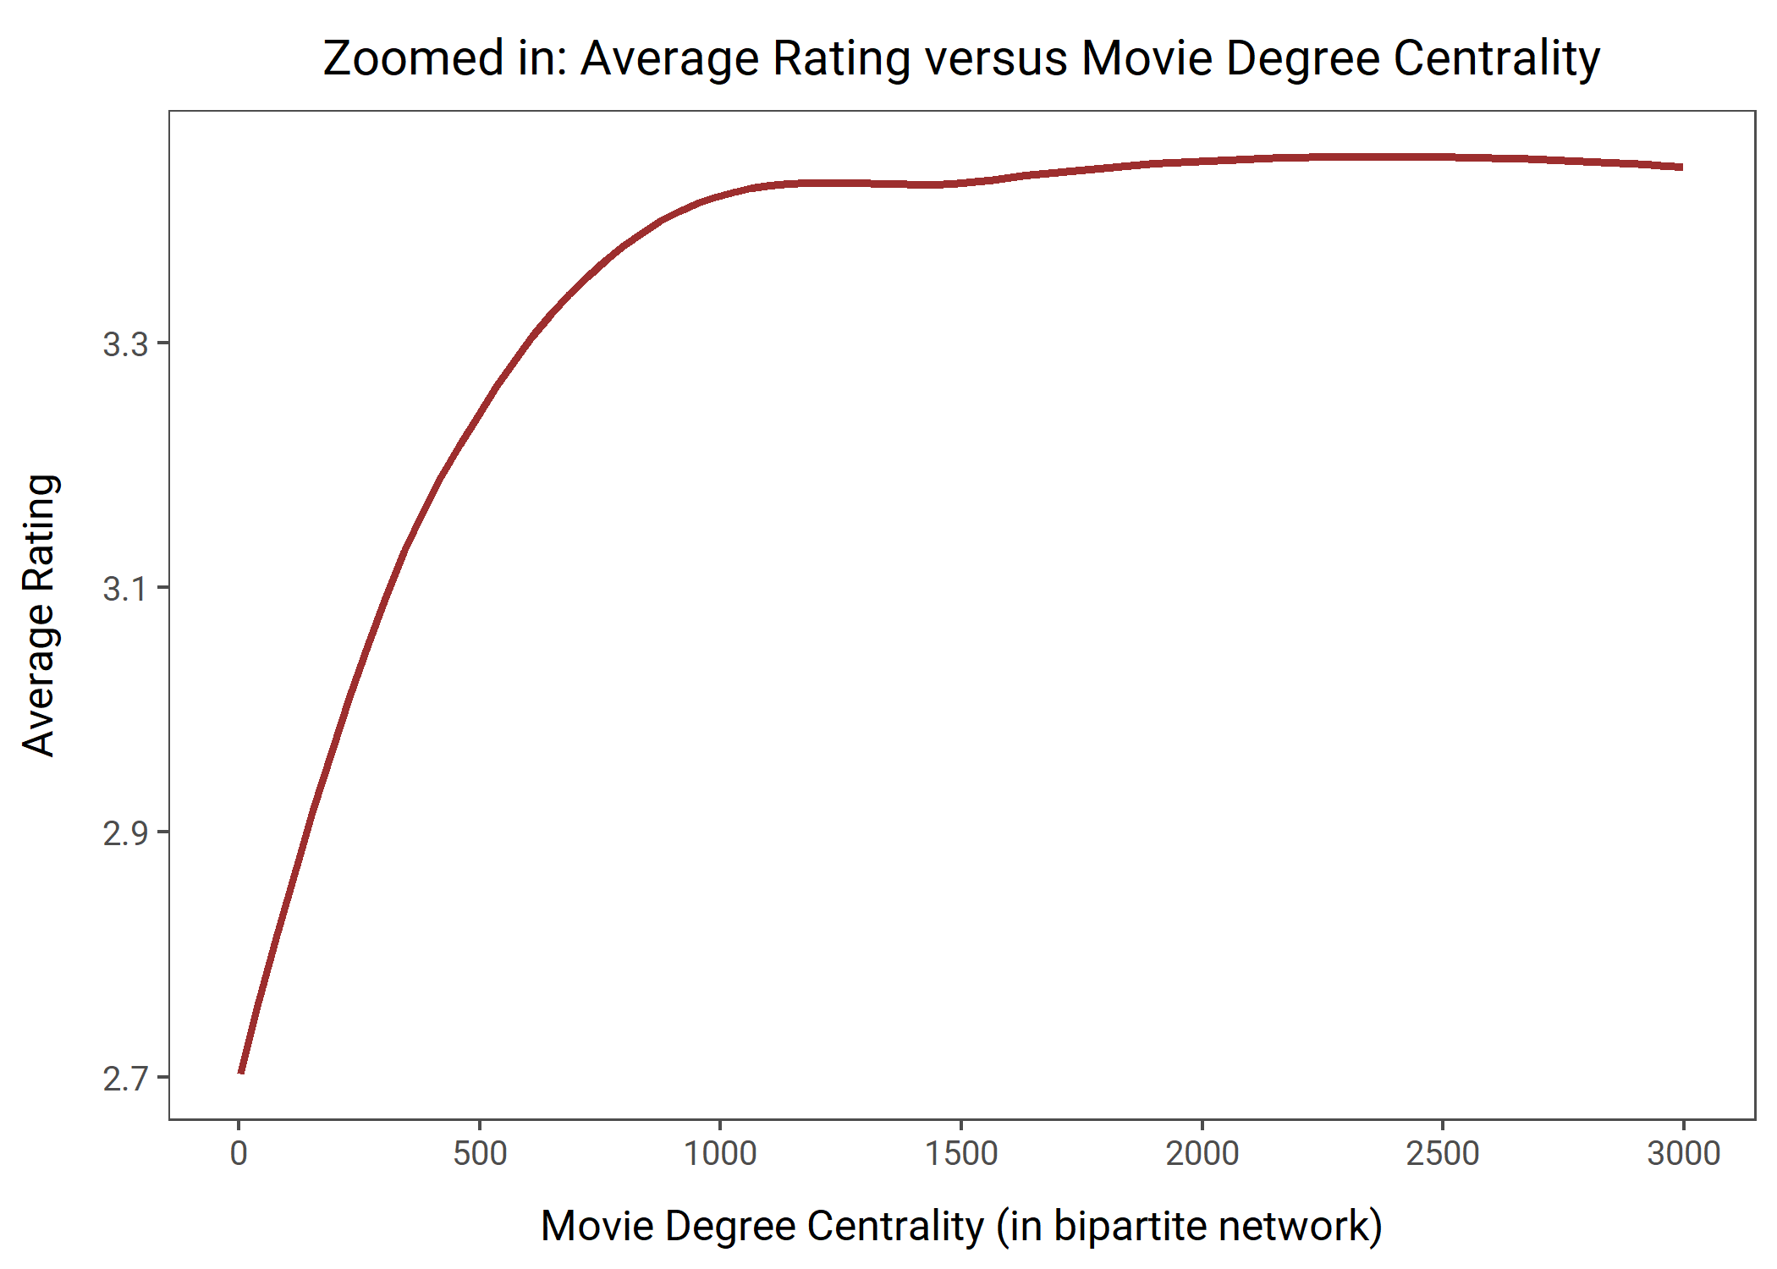
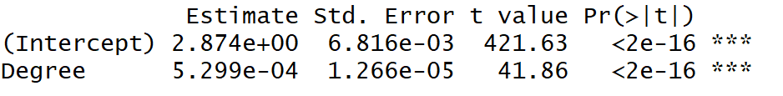
Higher movie ratings tend to be associated with higher movie degree centrality, up to a point
The average rating of a movie is tied to the number of ratings it has received
A positive, linear relationship exists for movies with fewer than 1000 ratings

Slide 12
For our model buildout, we would be looking at five different recommender algorithms
User-based collaborative filtering
Item-based collaborative filtering
Singular Value Decomposition (SVD)
Popular
Finds users who are similar based on similar rating patterns
Recommends items that those similar users liked
“Users who are similar to you also liked…”
Finds users who liked an item
Recommends other items that those users or similar users also liked
“Users who liked this item also liked…”
Converts recommendation problem into an optimization problem
Predicts ratings for items given a user
Excellent in handling scalability and sparsity issues in CF
Recommends most popular items
Random
Recommends random items

Slide 13

User-based collaborative filtering (UBCF)
User-based filtering
Technique overview
Finds similar customers based on similar ratings
Recommends what those similar customers liked
Neighborhood based algorithm calculates the similarity between two users
Users’ similarity is measured using Pearson or cosine similarity
Prediction by taking weighted average of all ratings
Viewed and liked by both users
Similar users
Pros
No training or optimization required, hence easy
Easy to explain and implement
Cons
Challenges dealing with sparse data i.e. few ratings per user
Computation time can be large/unfeasible
Users’ preference can change over time
Viewed and liked by her, Recommend to him

Slide 14
Item-based collaborative filtering (IBCF)
Technique overview
Item-based filtering
Finds similarities between items based on ratings
Typically use rating correlation or cosine similarity
Recommends most similar items to a user’s already-rated items
Viewed and liked by user
Pros
Good at handling situations where there are too many users since focus is on item similarity
More stable than UBCF because items tend to have a lot of ratings, so an individual rating has less impact
Less susceptible to changing user preferences over time
similar
items
Recommend to user
Cons
Can have challenges with sparse data if some items have few ratings
Can be challenging to explain, and has inconsistent effectiveness

Slide 15








Singular Value Decomposition (SVD)
Factor 2
Technique overview
Serious
Maps users and items into latent space
Converts recommendation problem into an optimization problem
Uses feature reduction to speed up prediction process
Incorporates regularization to avoid overfitting
Makes use of characteristics of dataset to reduce error
The color purple
Brave heart
Amadeus
Factor 1
Geared towards
female
Geared towards
male
Pros
Ocean’s 11
Designed to address sparsity and scalability issues, and is typically faster to execute
Cons
Can be challenging to explain and use, given complexity of data science techniques involved
The princess diaries
The lion king
Dumb and dumber
Funny

Slide 16
Popularity and random recommender algorithms are especially helpful in tackling the cold start problem
Handling new users using popular systems
Handling new items using random systems
If you are doing personalization, this is a problem since there is no data to personalize on
One solution is to recommend the popular items which are demographically relevant
Product association
Get explicit preferences (products, attributes)
Can’t recommend but need ratings (or equivalents) quickly
Use content-based approaches as an early proxy
Recommend to random, or well-chosen set of people

Slide 17
To start, we randomly sampled 2,000 movies and 40,000 users to build recommender systems on top-N recommendations and to predict ratings
Selected users with more than 50 reviews
Used Cosine similarity and set n/k as 50
Ratings >= 4 are considered positives in the evaluation process
Model Creation and Evaluation Process:
Training
Test
30,000
users
75%
25%
10,000 users
Create models
For each user:
Use models to predict
5 algorithms,
2 measures
20 ratings given
The rest be held out
“Known”
To compute
Errors
True/False Positive Rates

Slide 18
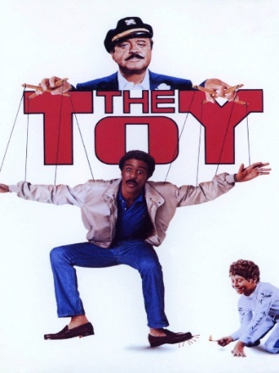







Illustrative example: user-based collaborative filtering recommender system
Movies a user in the test set watched and rated highly
Movies recommended in top-10 set by the recommender model created on training set
Align with
Step 03
Step 04

Slide 19
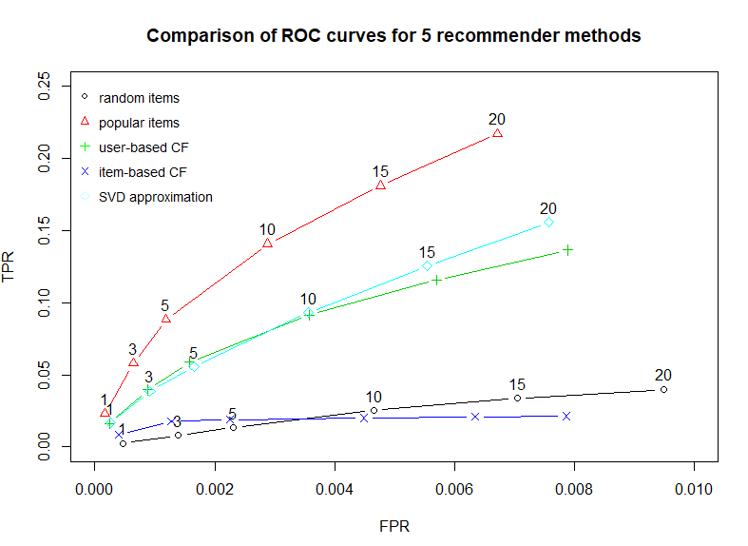
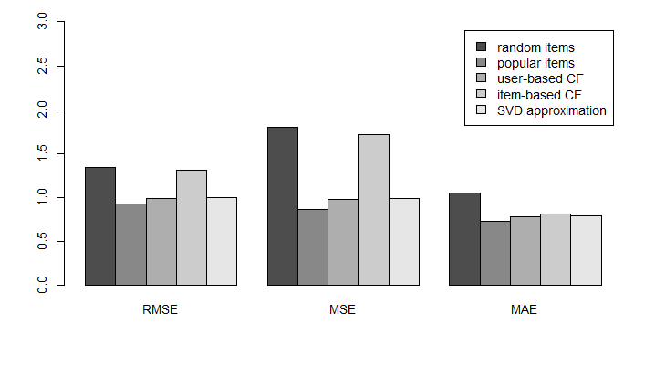
Initial model results indicate strongest performance by popular algorithm, although findings may change with larger data
ROC curve indicates popular method is best for topN prediction, followed by UBCF and SVD
Similar pattern emerges for rating prediction based on numeric metrics such as RMSE
Step 03
Step 04

Slide 20
Highest computation time associated with UBCF, while SVD emerges as the most efficient technique
 | TopN Prediction |  | Rating Prediction
Algorithm | Model Runtime (sec) | Prediction Runtime (sec) | Model Runtime (sec) | Prediction Runtime (sec)
Random | 0.00 | 22.33 | 0.02 | 9.20
Popular | 0.38 | 540.24 | 0.42 | 3.94
UBCF | 0.23 | 4189.56 | 0.30 | 4198.32
IBCF | 388.79 | 3.93 | 392.36 | 1.52
SVD | 19.96 | 22.23 | 18.81 | 10.33
Highest computation time for prediction involved for user-based collaborative filtering (followed by popular). This is likely because the approach taken is similar to k-nn, where similarity is evaluated at time of predicting
Item-based collaborative filtering requires relatively low prediction runtime, presumably because of the upfront computation of similar items matrix occurs in the initial model run. This also means it has the longest model runtime.
Singular value decomposition emerges as the most time-efficient technique

Slide 21
Thank you!
Questions?

Slide 22
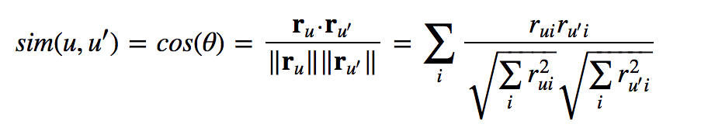
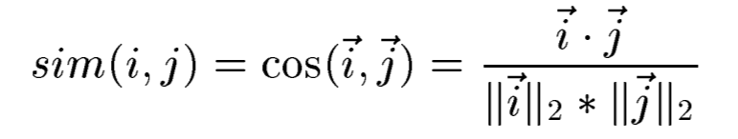
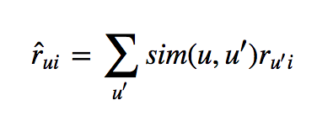
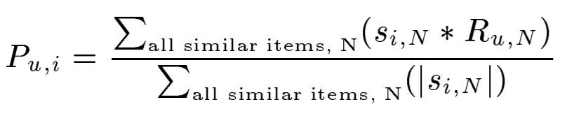
Appendix: Collaborative Filtering Techniques
User-based Collaborative Filtering
Item-based Collaborative Filtering
Users’ similarity is measured as the cosine of the angle between the two users’ vectors. Cosine similarity for users u & u′ is:
Items’ similarity is measured as the cosine of the angle between the two items’ vectors. Cosine similarity for items i & j is:
We can predict user-u’s rating for movie-i by taking weighted sum of movie-i ratings from all other users (u′s) where weighting is similarity number between each user and user-u.
Each predicted rating is weighted by the corresponding similarity between items i and j

